Slide 1



LAX2003 MOVIE REVIEW
6-POINT LAX

Slide 2


This course is offered to all students who have never taken LAX2003

Slide 3




Description
This is a six-week language activity which needs to be done outside of the lecture hours.
In this activity, students watch movies from the list given and review them. Please refer to the tips provided in the official website/PutraBlast for more information.
In groups of 8-10, students are required to video-record their weekly meetings. Then group leader uploads the Video and Submission Form onto online cloud storage via the link provided by his/her instructor. Next, group leader turns in a copy of the Submission Form via the assignment post in PutraBlast before the deadline.

Slide 4

What do I have to do throughout the 6 weeks?

Slide 5
What do I have to do throughout the 6 weeks?
WEEK | TASK
Week 1 & 2 | Student Registration (SMP)
Week 3 | Identify genre and Movie 1. Justify their selection. Submit Group Discussion 1 video.
Week 4 | Review Movie 1. Submit Group Discussion Video 2.
Week 5 | Identify genre and Movie 2. Justify their selection. Submit Group Discussion 3 video.
Week 6 | Review Movie 2. Submit Group Discussion Video 4.
Week 7 | Identify genre and Movie 3. Justify their selection. Submit Group Discussion 5 video.
Week 8 | Review Movie 3. Submit Group Discussion Video 6
The list of movies for LAX2003 can be found on the CALC website. https://calc.upm.edu.my/lax_sem_2_2025_2026-4600

Slide 6



LAX DAY 2026
Date: 10 June 2026
Day: Wednesday
Venue: Online Platform

Slide 7
LAX DAY Discussion video
10 – 15 minutes
Share your experience attending LAX Day 2026
Refer to notes in the timeline for further instructions

Slide 8


Group Discussion Video (Virtual)
Submitted on a weekly basis before the deadline (please refer to Timeline and Submission Schedule).
IMPORTANT NOTE:
The video must feature all group members participating actively and speaking for at least 2 minutes.
You need to ensure everyone’s face appears on the screen throughout the discussion session.
Each video should be about 20 to 25 minutes.

Slide 9



We’re going virtual!
All LAX activities on Sem 2 (25/26) will be conducted virtually.
Therefore, group discussion meetings will be conducted via a video conferencing platform and NOT face-to-face.
Students are required to conduct the group discussion meetings via a video conferencing platform (e.g., Skype, Zoom, Google Meet, WhatsApp, FaceTime etc.).
The virtual group discussion meetings must be video recorded (screen recording). Submit the video via the cloud storage link provided.

Slide 10
How do I get my LAX materials?
Please go to https://calc.upm.edu.my/lax_sem_2_2025_2026-4600
2. This is the official site for all LAX activities.
3. Please download all documents for your LAX activity (Timeline, Weekly Submission Schedule, Briefing Slides, Submission Form and etc.) from the official site.

Slide 11

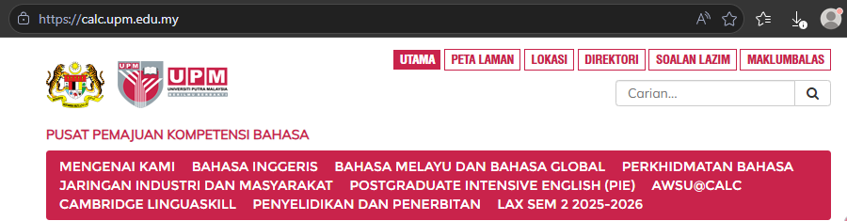
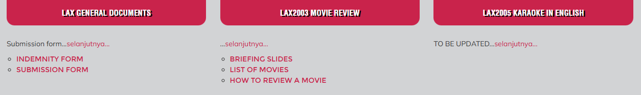
LAX materials calc.upm.edu.my
Note: Submission form can be downloaded under LAX General Documents tab.

Slide 12
Visit the CALC website/PutraBlast and ensure that you:
Print out the Timeline from the website so that you know what to do and what to submit throughout the 6 weeks,
Print out
Print out the Timeline and Submission Schedule from the website to avoid missing a deadline.
Check out
Check out your instructor’s welcome note from Putrablast.
If you are the group leader, check out the group’s online cloud storage in the instructor’s welcome note and join the group’s online cloud storage A.S.A.P using only your UPM student email.
Contact
Contact all group members and set up the date and venue for your group meeting.
Check out
Check out the Instructor List on the website or Putrablast and get your instructor’s contact details.
Print out

Slide 13
Who is my instructor? How do I find him/her?
Check PutraBlast.
Your instructor’s name, instructor’s contact details, instructor’s welcome note and online cloud storage are on PutraBlast.

Slide 14


What to do?
Decide on the day, date and time of the meeting.
Send your meeting invitation.
Join the meeting using your full names as stated on SMP.
(e.g. Names such as iPhone, Huawei etc. and nicknames are not acceptable).
Turn on your face cam, and you must be visible throughout the meeting as proof of attendance. Refer to your instructors if you do not have the ability to do so.

Slide 15

What to do?
Only group leader (with UPM student email) should submit:
- The Submission Form and video in online cloud storage
- A copy of the Submission Form at the assignment post on Putrablast before the deadline.
Ensure each recorded video submission on online cloud storage does not exceed the maximum size of 100mb a video
Please refer to the Timeline for tasks that need to be done. Take note that tasks for LAX conducted virtually might differ from the tasks assigned for face-to-face LAX.
IMPORTANT NOTE: Submission Forms should be turned in via Putrablast before the deadline. Submission Forms that are posted after the deadline or emailed to the instructor will be rejected.

Slide 16
When recording your video, please remember to:
State the discussion session, e.g. “Today, we are recording group discussion video 1”
Introduce yourself at the beginning of each video,
State the name(s) of any group members who is/are absent
Speak clearly and loudly
Ensure there is no background noise that may affect the clarity of your voice
Keep to the time-frame set for each video
Ensure all group members appear on the same screen throughout the recording.
Take part actively

Slide 17
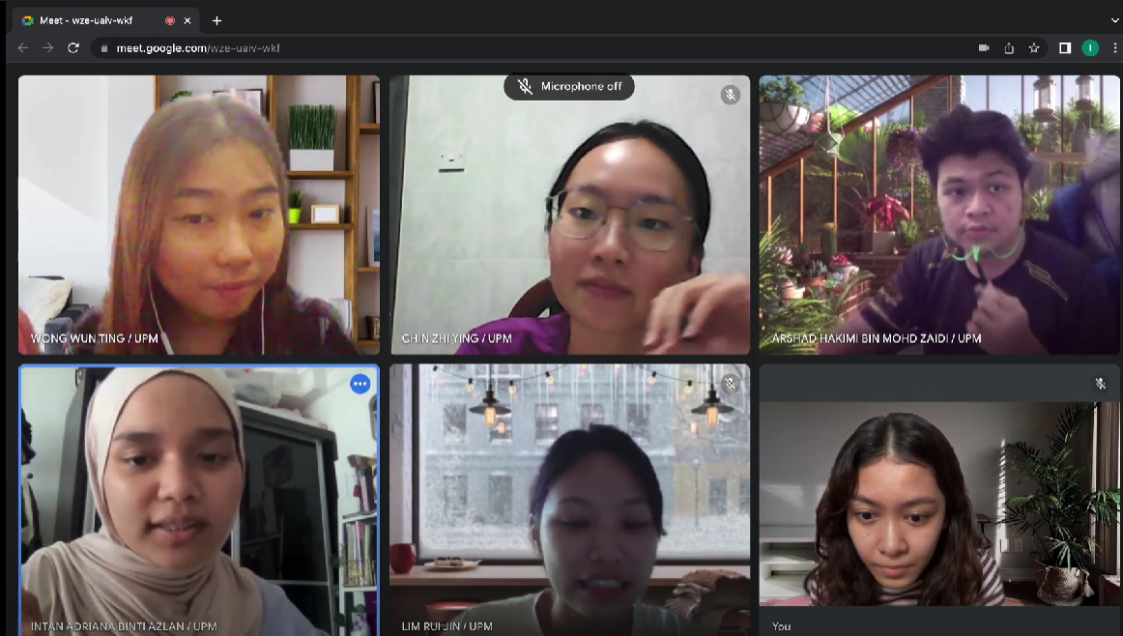
Group Discussion Video
Ensure that everyone appears on the screen throughout the discussion.
(Do not submit an individual video recording or a video which is merged as a group video recording from individual videos)

Slide 18

TAKE NOTE
You are not required to include a recording of you watching the movie in the Group Discussion Video recording

Slide 19

The group leader should
1
2
Upload the group discussion video and submission form onto online cloud storage via the submission link given by his/her instructor.
Turn in a copy of the Submission Form via PutraBlast before the submission deadline. Only ONE submission is required on online cloud storage and PutraBlast each week.

Slide 20

Assessment
Attendance (100%)
80% and above
Recorded based on participation in the group discussion/reflection videos.
Students are not required to sign any attendance forms.
Students must submit their MCs or excuse letters (if any) if they fail to attend any of the group discussion sessions to avoid being awarded a zero for attendance. (please contact your respective instructors on how to do this or come to CALC office).
Task Completion (100%)
Submission of all tasks before the weekly deadline
Participation in the group discussions.
M = Memuaskan (Satisfactory)
TM = Tidak memuaskan (non satisfactory/fail)
100% + 100% / 2 = 100% (M or TM)

Slide 21
Any questions?
Contact your instructor
Or email laxteam.upm@gmail.com

Slide 22


