Slide 1







LAX2059
GOAT (Greatest Of All Time)
6-Point LAX www.calc.upm.edu.my

Slide 2
OFFERED TO:
Students who have never taken LAX 2059

Slide 3
LAX 2059 SYNOPSIS
This is a 6-week language activity which needs to be done outside of the lecture hours.
In this activity, students select and highlight personalities who have contributed outstandingly to their fields.
In groups of 6, students:
1. discuss the chosen personalities and reasons for their selection, and
2. video-record their weekly meetings and upload them onto a dedicated website.
In groups of 6, students are required to video-record their weekly meetings. Then group leader uploads the Video and Submission Form onto Google Drive via the link provided by his/her instructor. Next, group leader turns in a copy of the Submission Form via the assignment post in Putrablast before the deadline.

Slide 4
WHO IS MY INSTRUCTOR?
HOW DO I FIND HIM/HER?
Check PutraBlast.
Your instructor’s name, contact details, welcome note and Google Drive Link are in Putrablast.

Slide 5
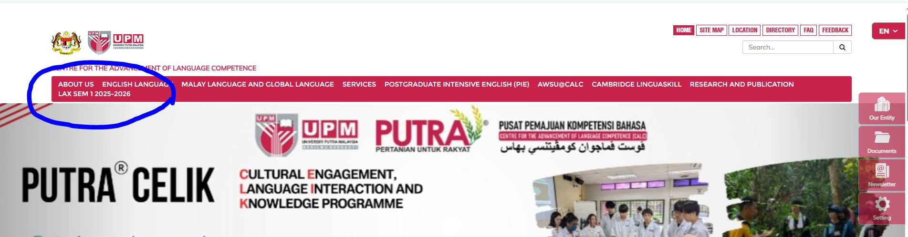
HOW DO I GET MY LAX MATERIALS?
  Please visit www.calc.upm.edu.my.

Slide 6
VISIT THE LAX BLOGSPOT/ PUTRABLAST AND ENSURE THAT YOU:
print out the Timeline from the CALC website so that you know what to do and what to submit throughout the 6 weeks,
Print out
print out the Weekly Submission Schedule from the website to avoid missing a deadline,
Check out
check out your instructor’s welcome note from Putrablast. If you are the group leader, check out the group’s Google Drive Link in the instructor’s welcome note and join the group Google Drive A.S.A.P using only your UPM student email.
Post
post your details (contact information, email address, etc.) in Putrablast, so that you can find your other group members
Contact
contact all group members and set up the date and venue for your group meeting.
Check out
check out your instructor's name on Putrablast and get your instructor’s contact details
Print out

Slide 7
WHAT TO DO?
Decide on
Decide on the day, date and time of the meeting. Send your meeting invitation.
Join
Join the meeting using your full names as stated in the SMP. (e.g., Names such as iPhone, Huawei etc. and nicknames are not acceptable).
Turn on
Turn on your face cam, and you must be visible throughout the meeting as proof of attendance. Refer to your instructors if you do not have the ability to do so.

Slide 8
WHAT TO DO?
The virtual group discussion meetings must be video recorded (screen recording).
Only group leader (with UPM student email) should submit:
the Submission Form and video in Google Drive
a copy of the Submission Form in the assignment post in Putrablast before the deadline.
Please refer to the Timeline for tasks that need to be done. Take note that tasks for LAX conducted virtually might differ from the tasks assigned for face-to-face LAX.
IMPORTANT NOTE: Submission Forms should be turned in via Putrablast before the deadline. Submission Forms that are posted after the deadline or emailed to the instructor will be rejected.

Slide 9
Group Discussion Video
12-15 minutes long.
Submitted on a weekly basis before the deadline (please refer to Weekly Submission Schedule - Student copy).
IMPORTANT NOTE: The video must feature all group members participating actively and speaking for at least 2 minutes.
Since LAX is conducted virtually, you need to ensure everyone’s face appears on the screen throughout the discussion session.

Slide 10
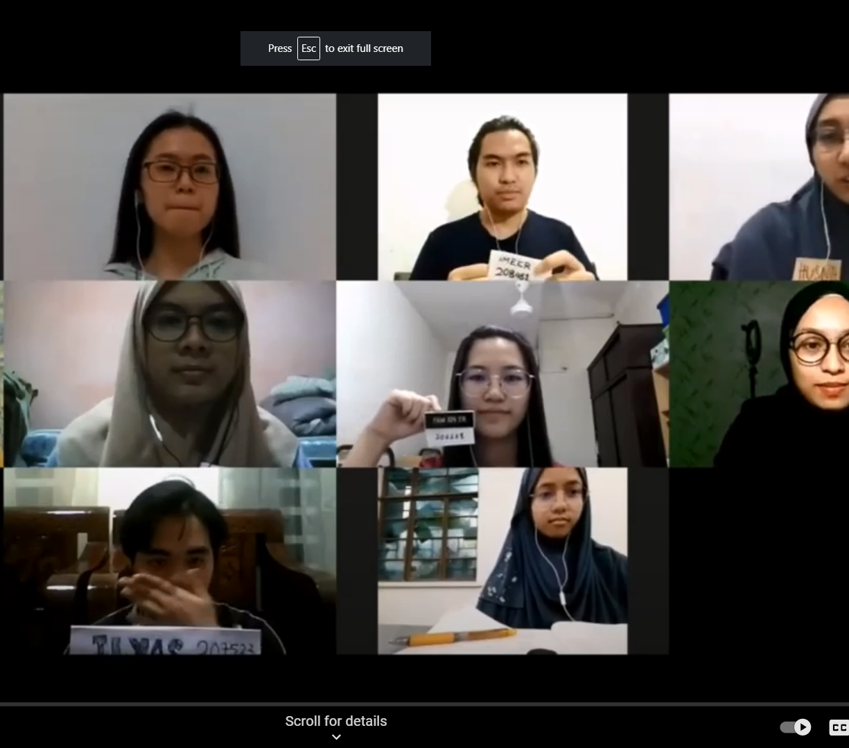
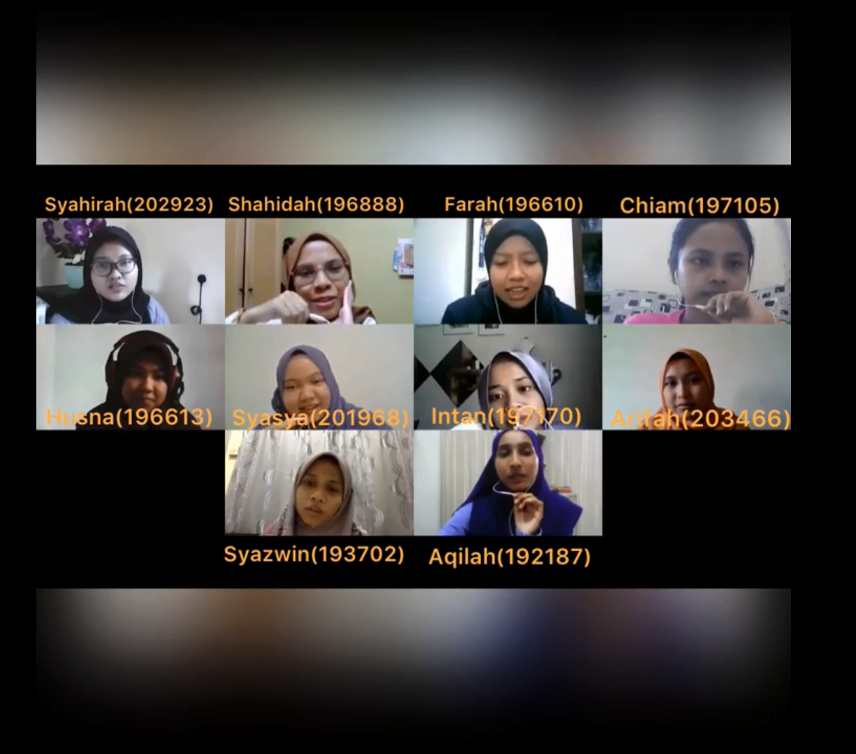
*Ensure that everyone appears on the screen throughout the discussion. (Do not submit an individual video or a video which merged a group video and an individual video.)

Slide 11
WHEN RECORDING YOUR VIDEO, PLEASE REMEMBER TO:
state the discussion session no, e.g. “Today, we are recording group discussion 1”
introduce yourself at the beginning of each video,
state the name(s) of any group members who is/are absent
speak clearly and loudly
ensure there is no background noise that may affect the clarity of your voice
take part actively
keep to the time-frame set for each video session

Slide 12
THE GROUP LEADER SHOULD:
Upload
upload the group discussion video and submission form onto Google Drive via the submission link given by his/her instructor.
Ask
ask for google drive access from your Google Drive Manager and use only UPM student email to do this. (Latest before Semester Break) After that AC will not entertain any student request)
Turn in
turn in a copy of the Submission Form via Putrablast before the submission deadline. Only ONE submission is required in Google Drive and Putrablast each week.

Slide 13
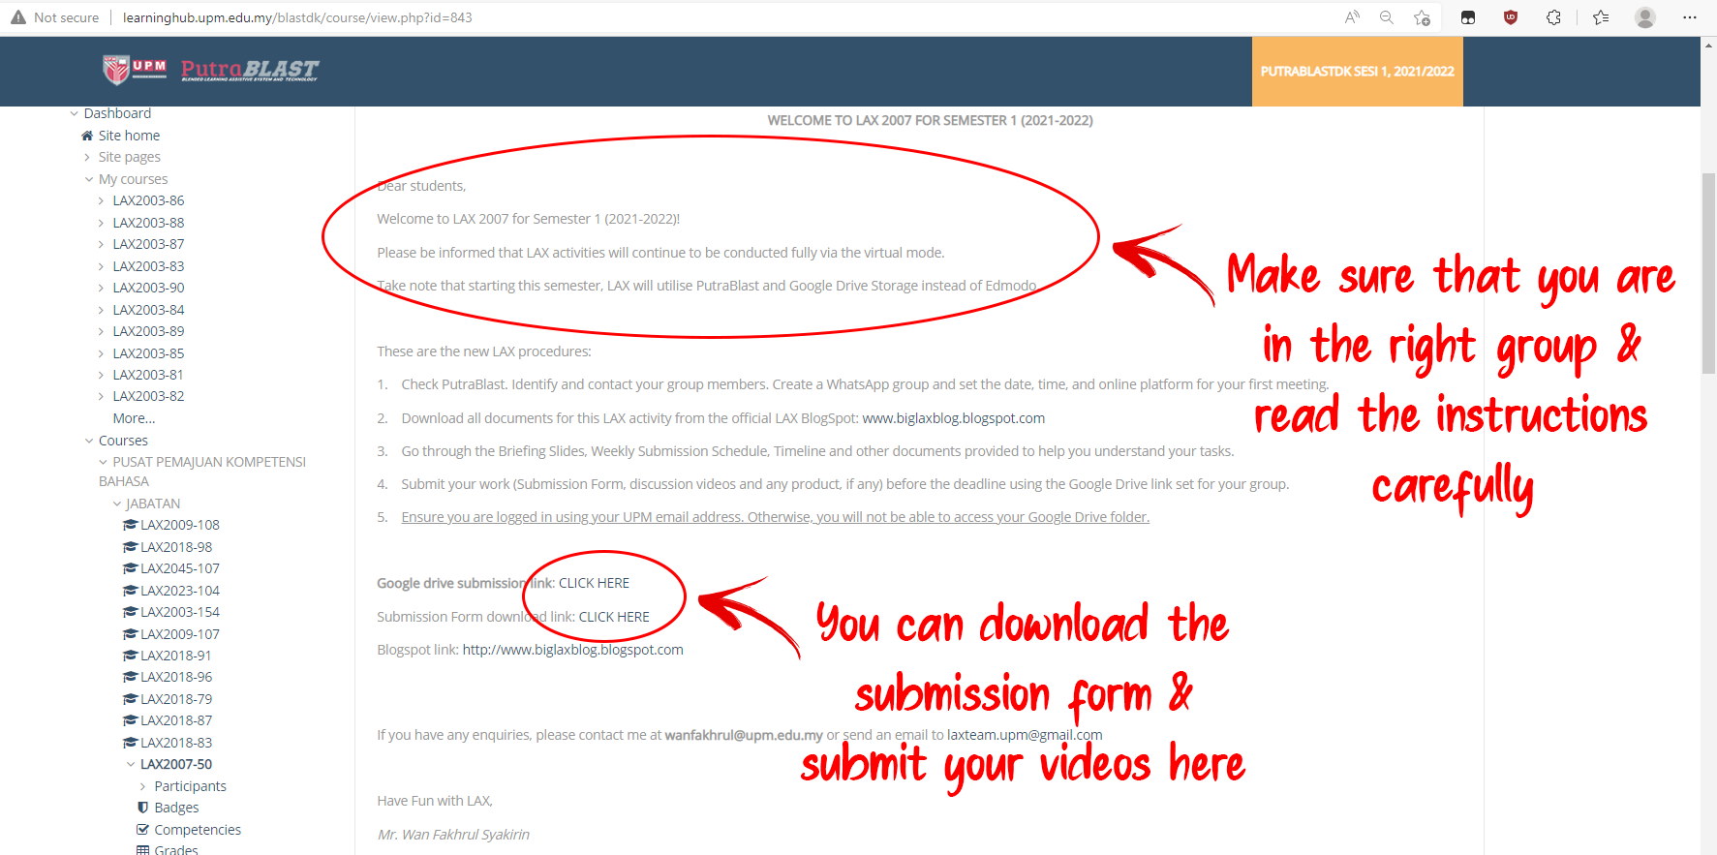
How To Submit Your LAX Video and Submission Form on Google Drive
STEP 1: Check your PutraBlast

Slide 14
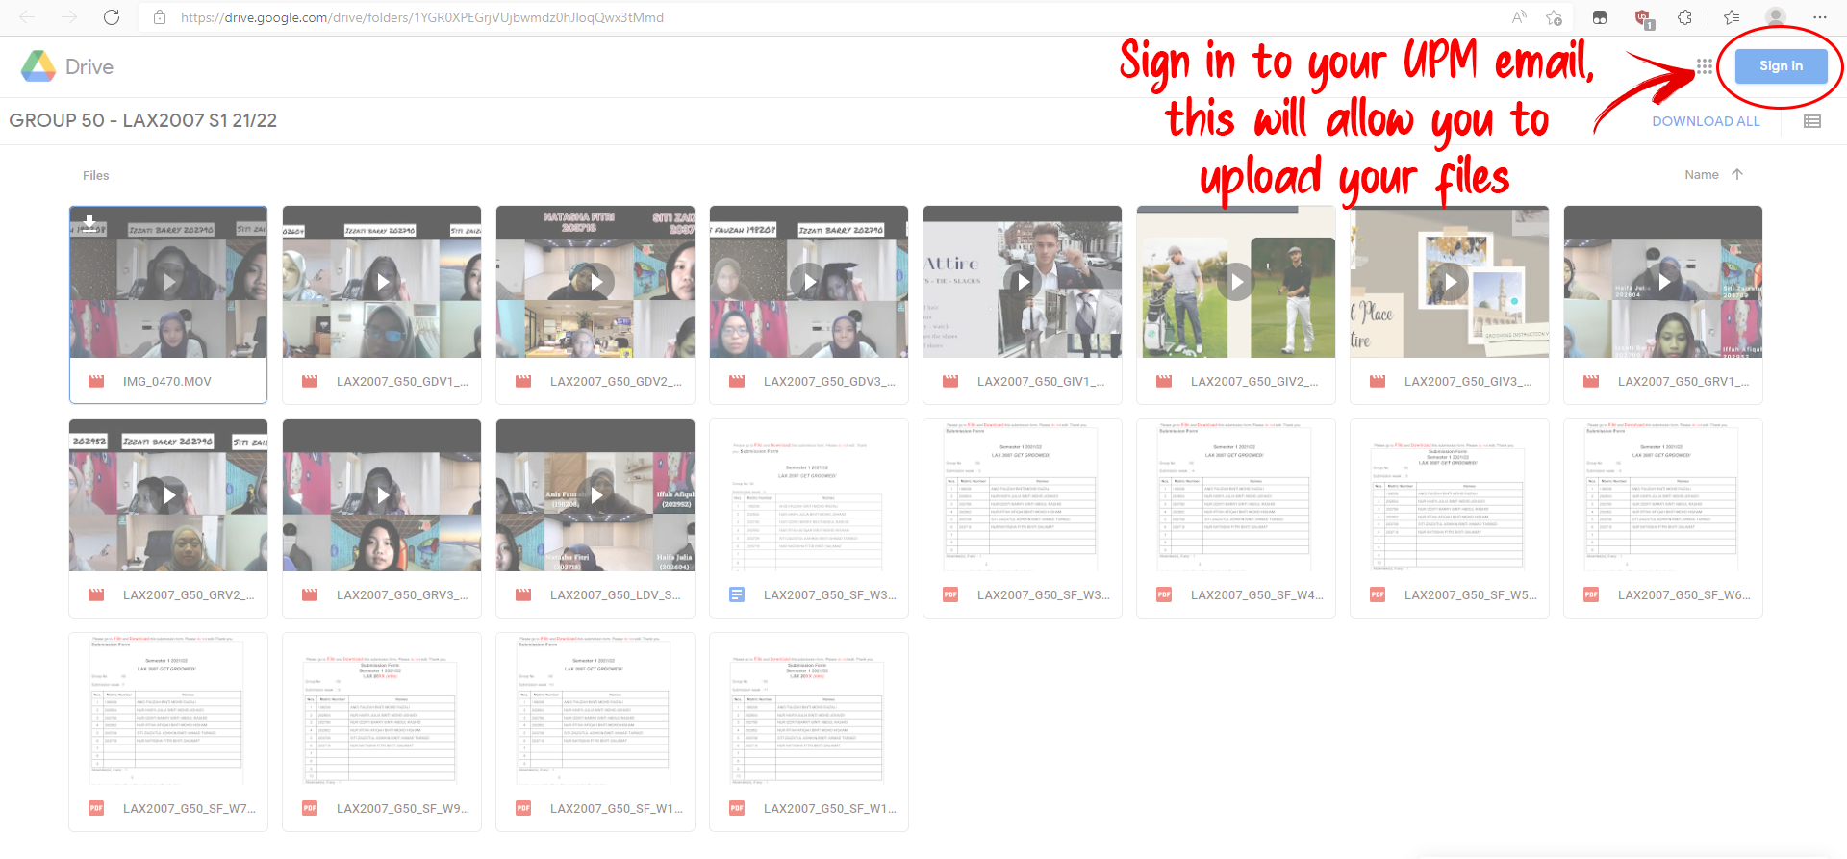
STEP 2: Sign in to UPM email

Slide 15
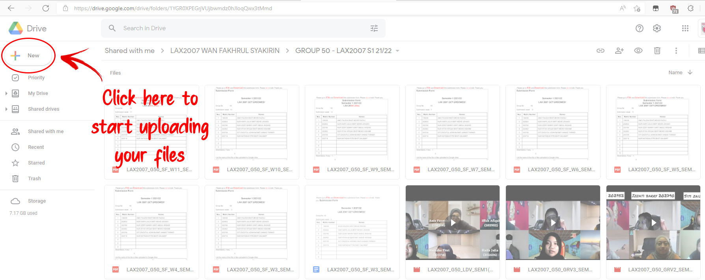
STEP 3: Start uploading

Slide 16
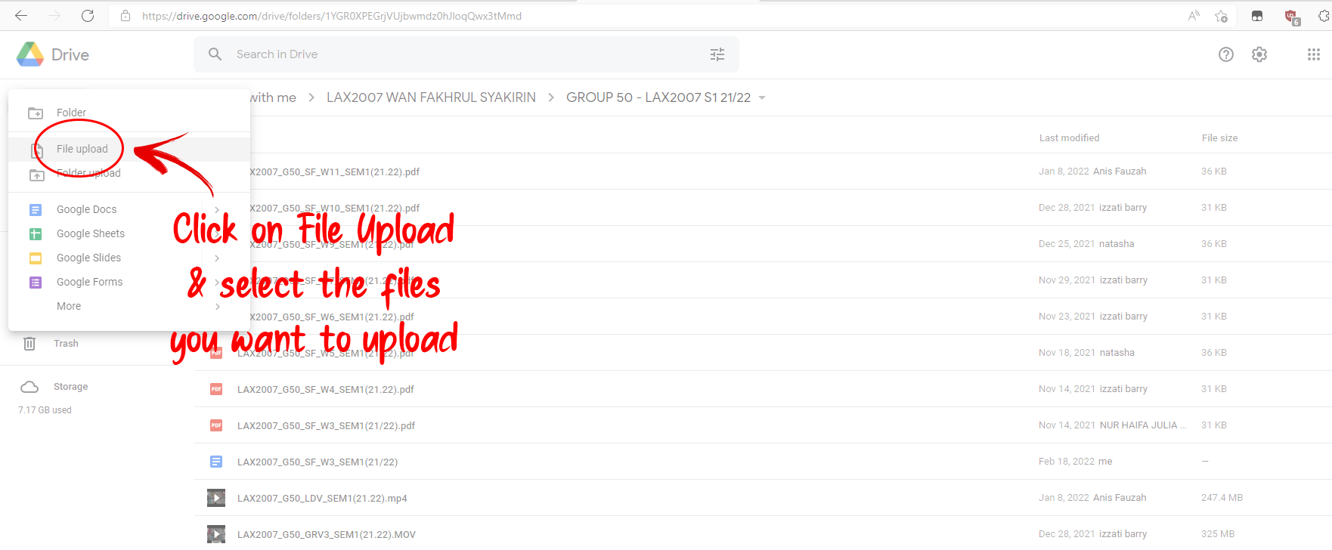
STEP 4: Select the files to be uploaded

Slide 17
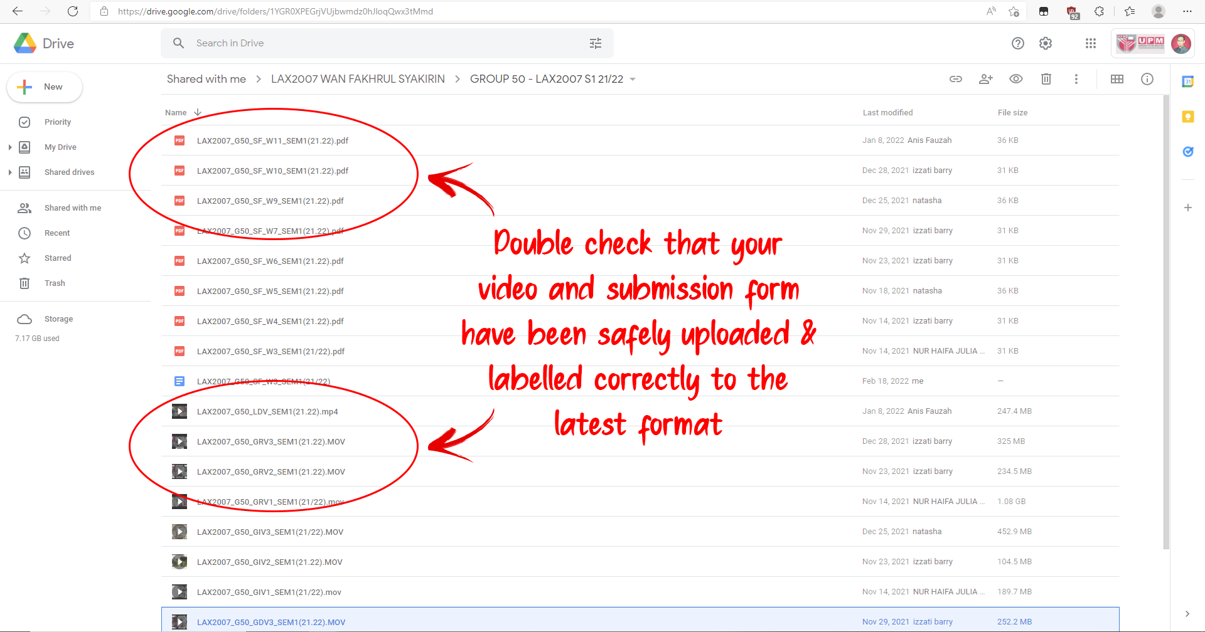
STEP 5: Check your submission

Slide 18
ASSESSMENT
A) Attendance (100%)
80% and above
Recorded based your participation in the weekly discussion sessions.
Students are not required to sign or submit any attendance forms.
Students must submit their MCs or excuse letters (if any) if they fail to attend the briefing session or any of the weekly discussion sessions to avoid from being awarded a zero for attendance.

Slide 19
ASSESSMENT
B) Completion of weekly task(s) (100%)
Submission of all tasks before the deadlines
Active participation in the group discussions
(A) 100% + (B) 100% / 2 = 100%
80% and above = M (memuaskan/satisfactory = Pass)
79% and lower = TM (tidak memuaskan/non satisfactory = Fail)

Slide 20
ANY QUESTIONS?
Please check out the FAQ section in the blogspot.
If you still cannot find the answer to your question, please contact your instructor directly or send an email to laxteam.upm@gmail.com

Slide 21
THE END
THANK YOU & GOODBYE!

