Slide 1


VIRTUAL
LAX 2047
POETIC SOCIETY
6-POINT LAX
Course Briefing

Slide 2
Offered To:
Students who have never taken LAX2047.

Slide 3
Synopsis:
This is a six-week language activity which needs to be done outside of the lecture hours.
Students are required to submit 6 group discussion videos.
Students are required to conduct the group discussion meetings via a video conferencing platform (e.g., Skype, Zoom, Google Meet, WhatsApp, FaceTime etc.).
The virtual group discussion meetings must be video recorded (screen recording) and submitted via the google drive link set for your group.

Slide 4

How Do I Get My Lax Materials?
  Please go to calc.upm.edu.my
  Download all documents you need (Timeline, Briefing Slides, Submission Form, etc.)
  Go through the welcome note posted by your instructor
  Find your instructor’s name, contact details, and the google drive submission link.

Slide 5
Task Summary
WEEK | TASK
Week 3 | Group discussion 1 Identify 2 global issues to be addressed in the coming weeks. Form 2 groups.
Week 4 | Group Discussion 2 Group 1 recite the poem and start group discussion about the poem.
Week 5 | Group Discussion 3 Group 2 recite the poem and start group discussion about the poem.
Week 6 | Group Discussion 4 Group 1 recite the poem regarding the second issue and start group discussion about the poem.
Week 7 | Group Discussion 5 Group 2 recite the poem regarding the second issue and start group discussion about the poem.
Week 8 | Group Discussion 6 Everyone discusses all the 4 poems created by the group and select the best poem.

Slide 6
Group Discussion Video
The group discussion video is divided into 2 parts:
Part 1 (2-3 minutes):
  Assigned group recites the poem.
  Other members will become the audience (faces should be visible at all time) although they are not required to speak during the poetry recital.
Part 2 (14-16 minutes):
  Students discuss the poem by sharing what they think about the poem, the meaning, the poem’s effectiveness in addressing the issue selected etc.

Slide 7

Group discussion Video
Decide on
Decide on the day, date and time of the meeting. Send your meeting invitation.
Join
Join the meeting using your full names as stated in the SMP. (e.g., Names such as iPhone, Huawei etc. and nicknames are not acceptable).
Turn on
Turn on your face cam, and you must be visible throughout the meeting as proof of attendance. Refer to your instructors if you do not have the ability to do so.

Slide 8
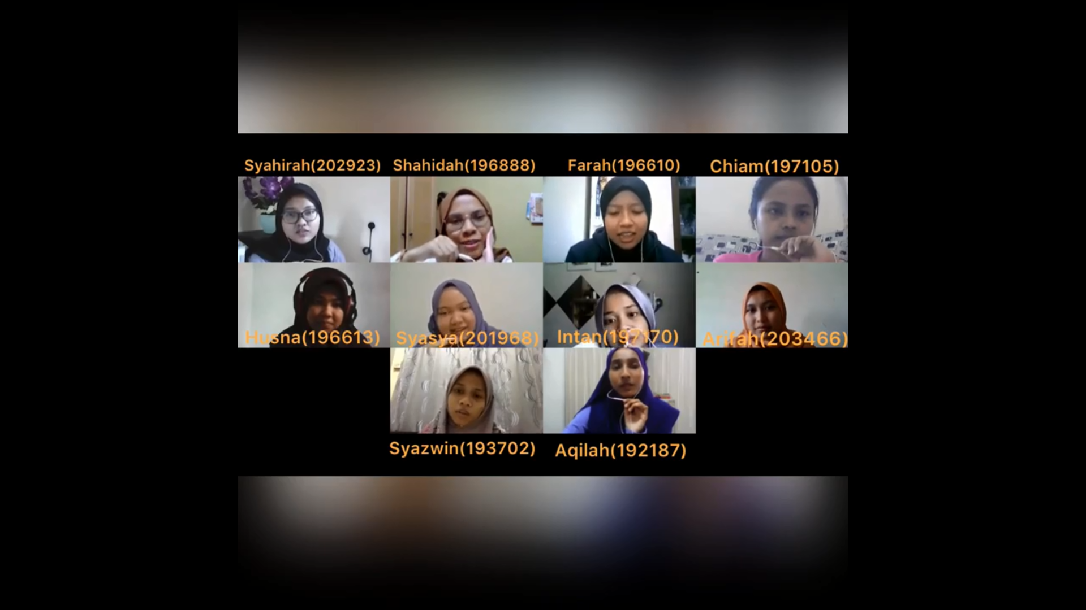
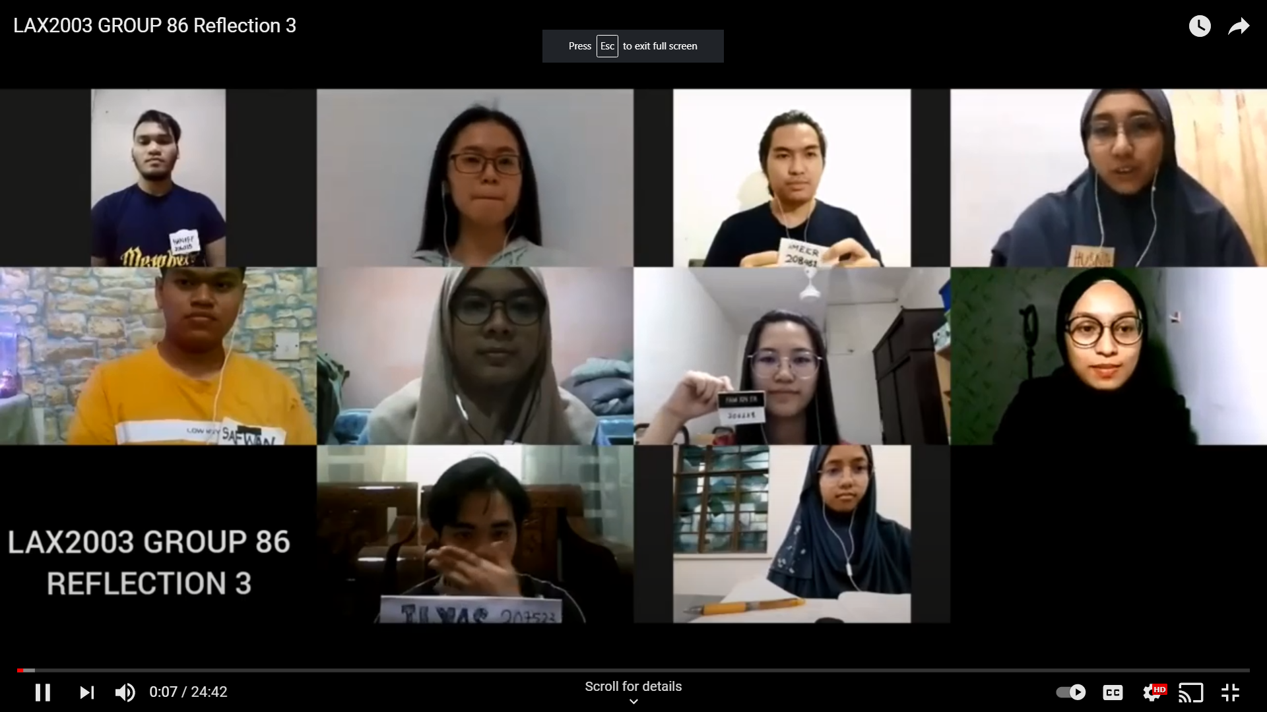
*Ensure that everyone appears on the screen throughout the discussion.
* Do not accept an individual video recording or a video which is merged a group video recording from individual videos.

Slide 9
When Recording Your Video, Please Remember To:
State the discussion session. E.g: “Today, we are recording group discussion video 2.”
Introduce yourself at the beginning of each video.
State the name(s) of any group members who is/are absent.
Speak clearly and loudly.
Ensure that there is no background noise that may affect the clarity of your voice.
Keep to the time-frame set for each video.
Ensure all group members appear on screen throughout the discussion session.

Slide 10
Submission
All discussions are screen recorded
Maximum video size is 100MB
All group members should introduce themselves at the beginning of each video
Do not submit an individual video or a merge of group and individual videos
Submission form should be submitted on PutraBlast and Google Drive
Discussion videos only have to be uploaded to Google drive

Slide 11
The Group Leader Should:
Upload
upload the group discussion video and subsion form ionto Google Drive via the submission link given by your lecturer.
Ask
ask for Goolge Drive access from your Google Drive Manager (teacher) and use only UPM email to do this.
Turn in
turn in a copy of the Submission Form via PutraBlast before the submission deadline. Only 1 submission is required in Google Drive and Putrablast each week.

Slide 12
Assessment
Attendance (100%)
80% and above
Recorded based your participation in the weekly discussion sessions (active participation).
Students are not required to sign or submit any attendance forms.
Students must submit their MCs or excuse letters (if any) if they fail to attend the briefing session or any of the weekly discussion sessions to avoid from being awarded a zero for attendance.

Slide 13
Assessment
B) Completion of weekly task(s) (100%)
Submission of all tasks before the deadlines
Active participation in the group discussions
(A) 100% + (B) 100% / 2 = 100%
80% and above = M (memuaskan/satisfactory = Pass)
79% and lower = TM (tidak memuaskan/non satisfactory = Fail)

Slide 14
Reminder
Please check out the FAQ section in the website.
If you still cannot find the answer to your question, please contact your instructor directly or send an email to laxteam.upm@gmail.com
You can only afford to miss 1 group meetings. You are at risk of getting a TM if you miss more than ONCE. Please ensure that you have the documents to support your absence from group meetings.

Slide 15
THE END
THANK YOU

