Slide 1
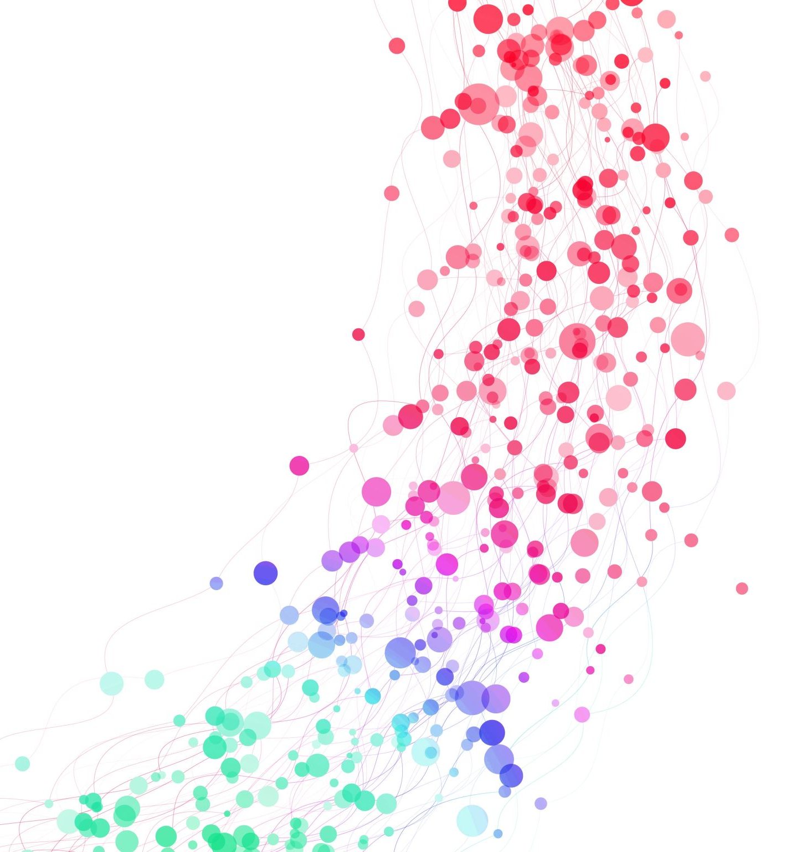
LAX 2009
Language Art
6-Point LAX
Activity Coordinator:
Mr. Rafie Suhaimi 0193683266

Slide 2

OFFERED TO
Students who have never taken LAX 2009

Slide 3
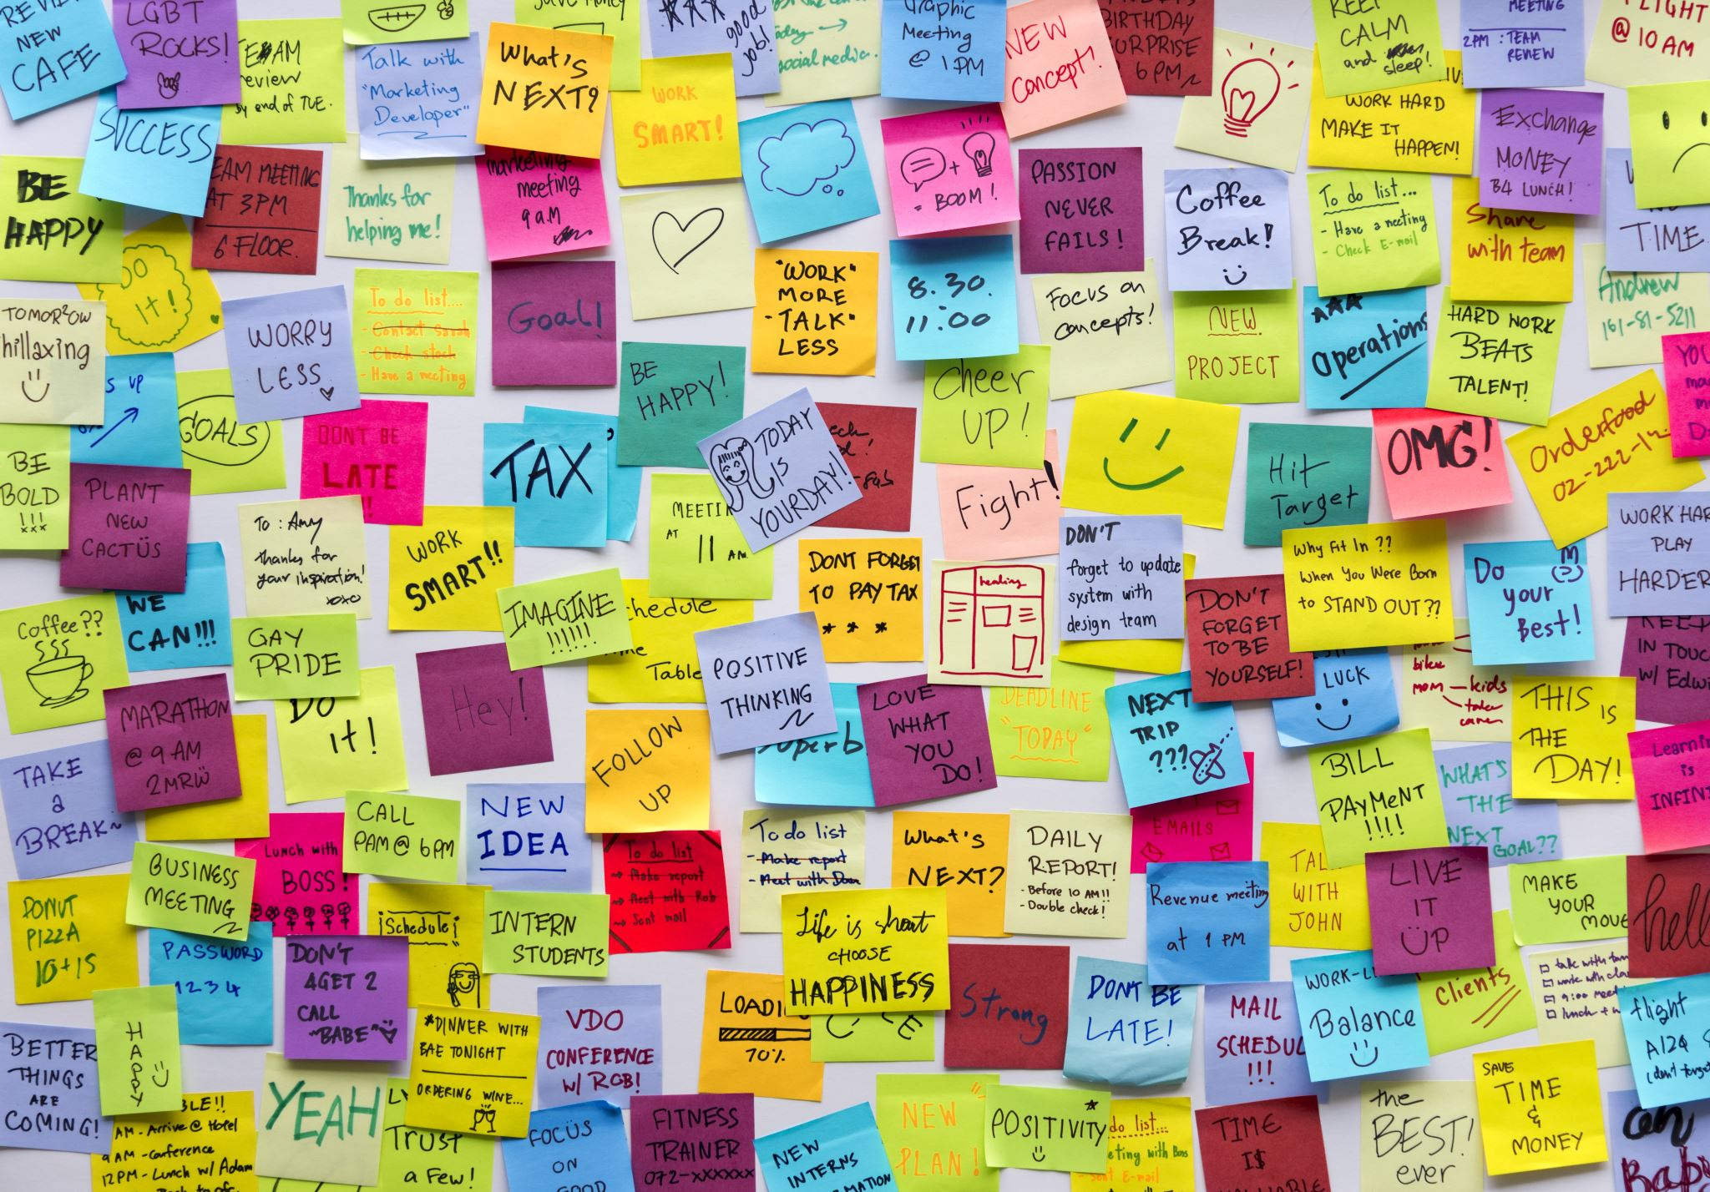
LAX Description
This is a six-week language activity which needs to be done outside of the lecture hours.
In this activity, students produce creative pieces such as greeting cards, bookmarks, stickers and motivational posters using adages, proverbs, and idioms in English.
In groups of 5-6, students:
design and produce at least five creative pieces,
video record their weekly meetings where each student take turns to describe their work

Slide 4

CLICK ON THE IMAGE TO PLAY THE VIDEO

Slide 5
What do I have to do throughout the 6 Weeks?
WEEK | TASK | NOTE
Week 1 | Student Registration (SMP)
Week 2 | Identify 5 Language Art projects that the group will be doing for the next 5 weeks. 1. Justify their selection. Submit Group Discussion 1 video. | Extended deadline
Week 3 | Each student presents/explains his/her work. Students discuss each other’s work, select the best artwork, refer to the focus list in the notes section and submits Group Discussion Video 2.
Week 4 | Each student presents/explains his/her work. Students discuss each other’s work, select the best artwork, refer to the focus list in the notes section and submits Group Discussion Video 3.
Week 5 | Each student presents/explains his/her work. Students discuss each other’s work, select the best artwork, refer to the focus list in the notes section and submits Group Discussion Video 4.

Slide 6
What Do the Students Have to Do throughout the 6 Weeks? (CON’T)
WEEK | TASK | NOTE
Week 6 | Each student presents/explains his/her work. Students discuss each other’s work, select the best artwork, refer to the focus list in the notes section and submits Group Discussion Video 5.
Week 7 | Each student presents/explains his/her work. Students discuss each other’s work, select the best artwork, refer to the focus list in the notes section and submits Group Discussion Video 6.

Slide 7
GROUP DISCUSSION VIDEOS
10 – 15 minutes long.
Submitted on a weekly basis before the deadlines (please refer to Weekly Submission Schedule or Timeline Student copy).
Each student would take turns to describe their art pieces. They may talk about;
  the sayings, proverbs, idioms or wise words chosen, and what they mean, and
  the chosen design or colours.

Slide 8



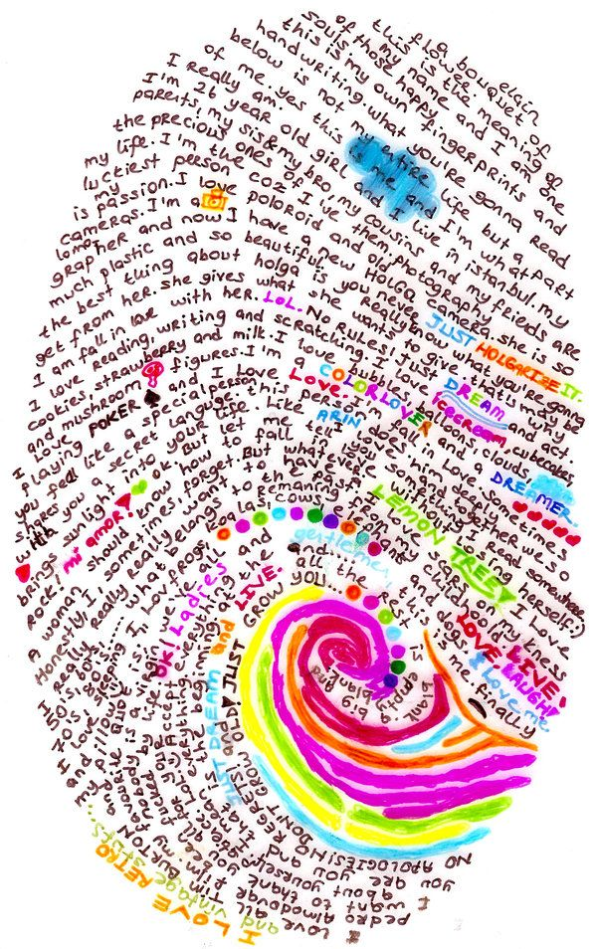
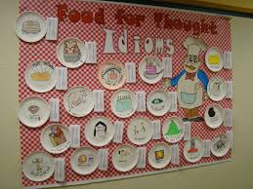
Project Suggestions:
(Don’t forget to include the use of english idioms, adages and proverbs.)
Bookmarks
Creative posters
Greeting cards
Origamis
Decorative items
Motivational posters
Stickers

Slide 9
Important reminder
The group discussion meetings must be video recorded (screen recording). Submit the video via the google drive link provided.
All LAX activities on Sem 1 (25/26) will be conducted in hybrid mode. Therefore, group discussion meetings can be conducted via a video conferencing platform or face-to-face.

Slide 10
How do I get my LAX materials?
Please go to https://calc.upm.edu.my
This is the official site for all LAX activities.
Please download all documents for your LAX activity (Timeline, Weekly Submission Schedule, Briefing Slides, Submission Form and etc.) from the blogspot.

Slide 11
VISIT THE CALC WEBSITE/ PUTRABLAST AND ENSURE THAT YOU:
print out the Timeline from the LAX Blogspot so that you know what to do and what to submit throughout the 6 weeks,
Check out
check out your instructor’s welcome note from Putrblast. If you are the group leader, check out the group’s Google Drive Link in the instructor’s welcome note and join the group Google Drive A.S.A.P using only your UPM student email.
Post
post your details (contact information, email address, etc.) in Putrablast, so that you can find your other group members
Contact
contact all group members and set up the date and venue for your group meeting.
Check out
check out the Instructor List in the Blogspot or Putrablast and get your instructor’s contact details
Print out

Slide 12
WHAT TO DO?
Decide on
Decide on the day, date and time of the meeting. Send your meeting invitation.
Join
Join the meeting using your full names as stated in the SMP. (e.g., Names such as iPhone, Huawei etc. and nicknames are not acceptable).
Turn on
Turn on your face cam, and you must be visible throughout the meeting as proof of attendance. Refer to your instructors if you do not have the ability to do so.

Slide 13
What to do?
Only the group leader (with UPM student email) should submit:
the Submission Form and video on Google Drive
a copy of the Submission Form at the assignment post on Putrablast before the deadline.
Please refer to the Timeline for tasks that need to be done. Take note that tasks for LAX conducted virtually might differ from the tasks assigned for face-to-face LAX.
IMPORTANT NOTE: Submission Forms should be turned in via Putrablast before the deadline. Submission Forms that are posted after the deadline or emailed to the instructor will be rejected.
Ensure each recorded video submission on Google Drive does not exceed the maximum size of 100MB a video.

Slide 14
WHEN RECORDING YOUR VIDEO, PLEASE REMEMBER TO:
state the discussion session no, e.g. “Today, we are recording group discussion 1”
introduce yourself at the beginning of each video,
state the name(s) of any group members who is/are absent
speak clearly and loudly
ensure there is no background noise that may affect the clarity of your voice
take part actively
keep to the time-frame set for each video session

Slide 15
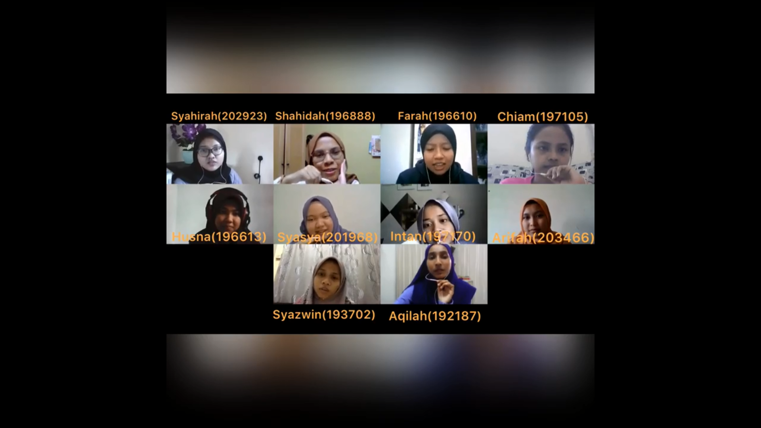
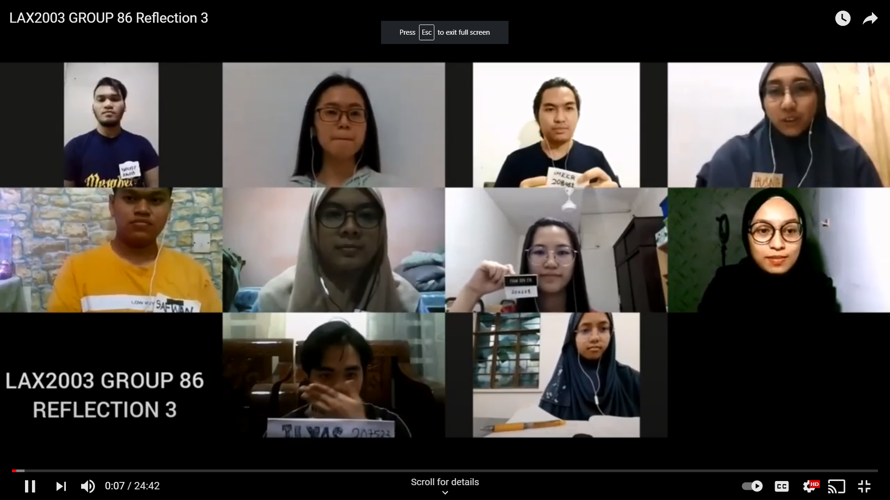
*Ensure that everyone appears on the screen throughout the discussion.
Do not submit an individual video or a video which merged a group video and an individual video.

Slide 16
THE GROUP LEADER SHOULD:
Upload
upload the group discussion video and submission form onto Google Drive via the submission link given by his/her instructor.
Ask
ask for google drive access from your Google Drive Manager and use only UPM student email to do this. (Latest before Semester Break) After that AC will not entertain any student request)
Turn in
turn in a copy of the Submission Form via Putrablast before the submission deadline. Only ONE submission is required in Google Drive and Putrablast each week.

Slide 17
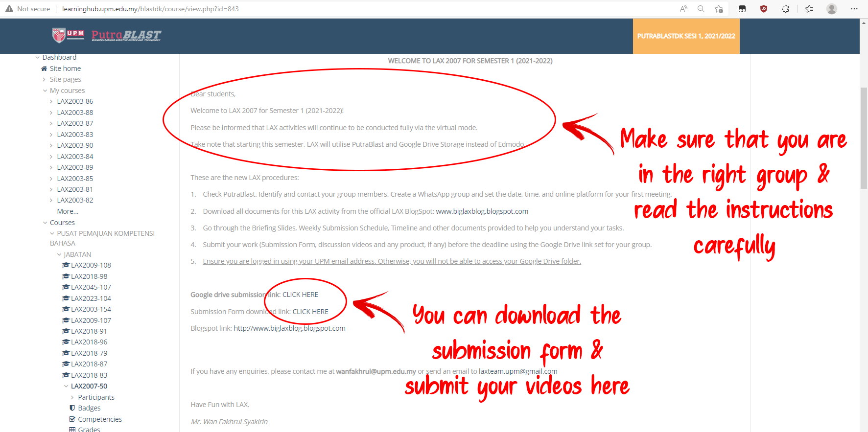
HOW TO SUBMIT YOUR LAX VIDEO AND SUBMISSION FORM ON GOOGLE DRIVE
STEP 1: Check your PutraBlast. (This is meant for group leader only)

Slide 18
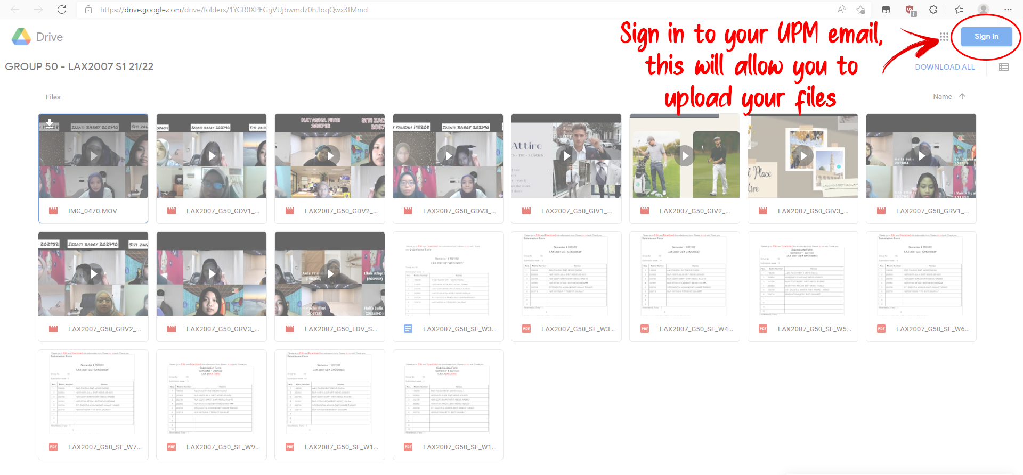
STEP 2: Sign in to UPM email. (This is meant for group leader only)

Slide 19
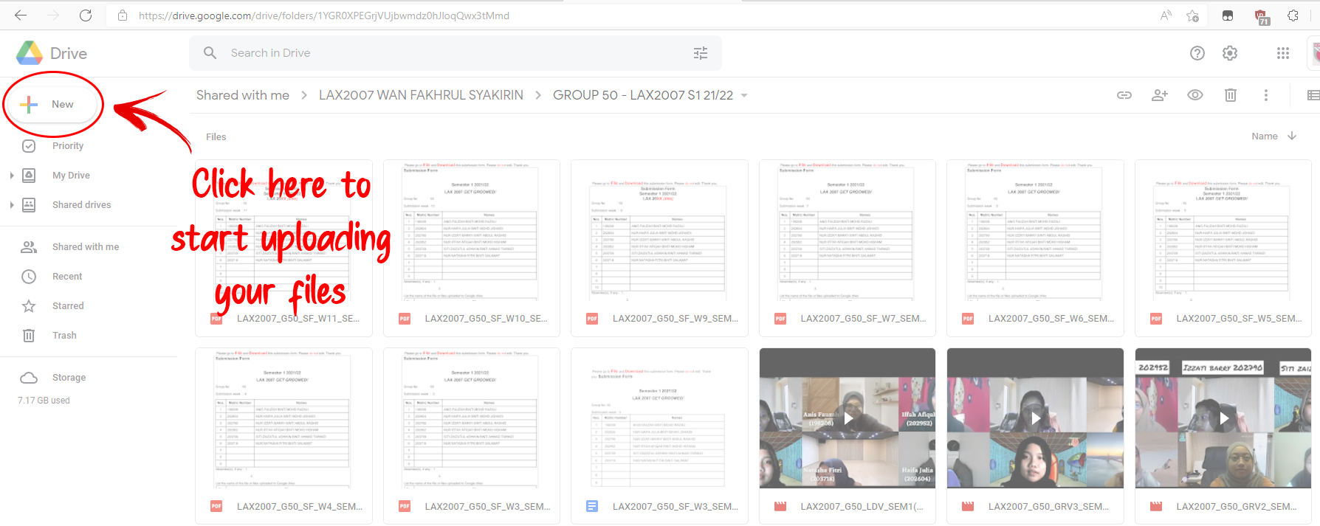
STEP 3: Start uploading. (This is meant for group leader only)

Slide 20
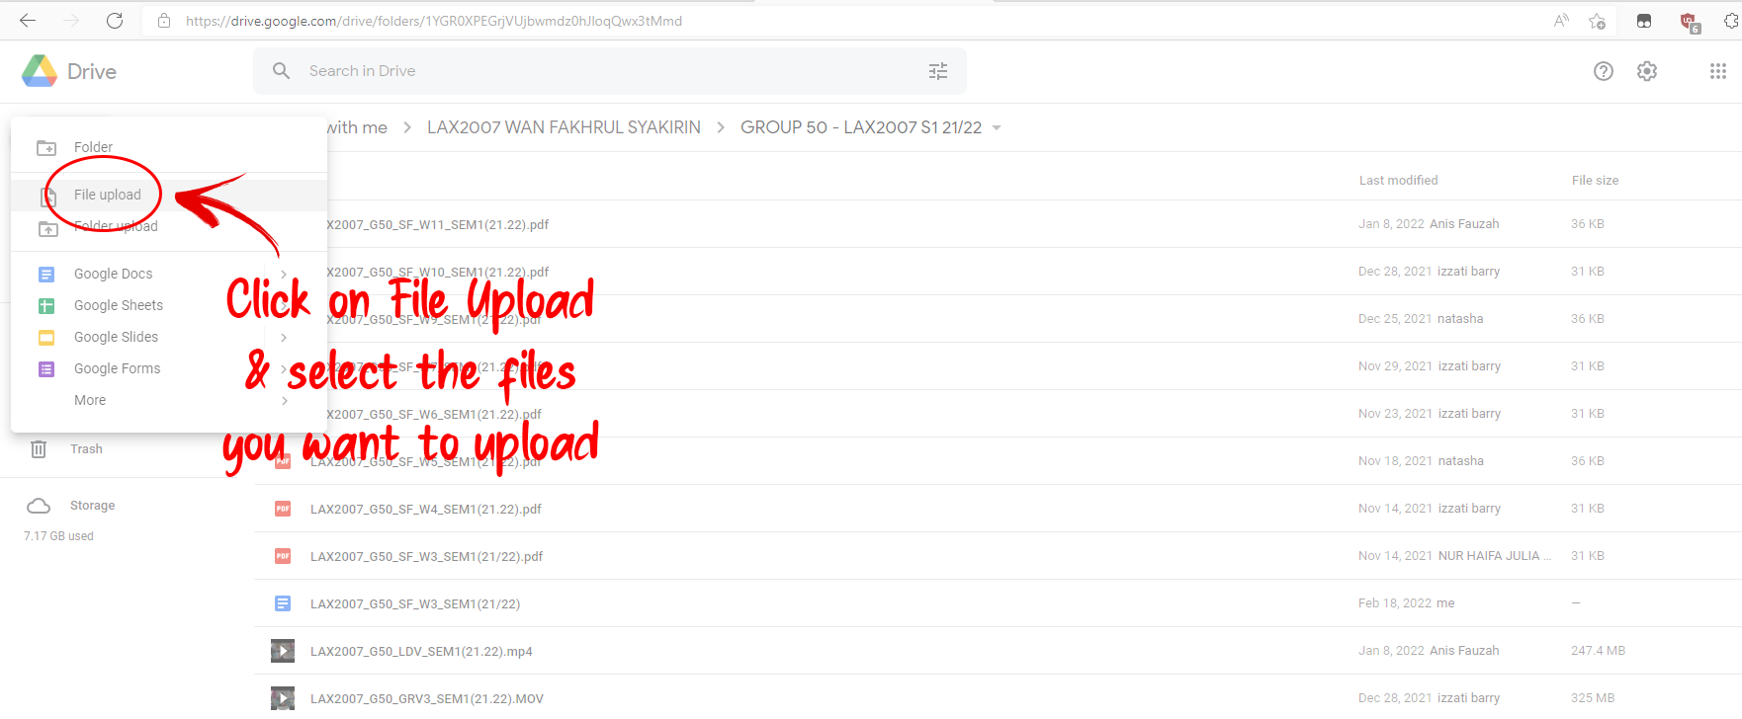
STEP 4: Select files to be uploaded. (This is meant for group leader only)

Slide 21
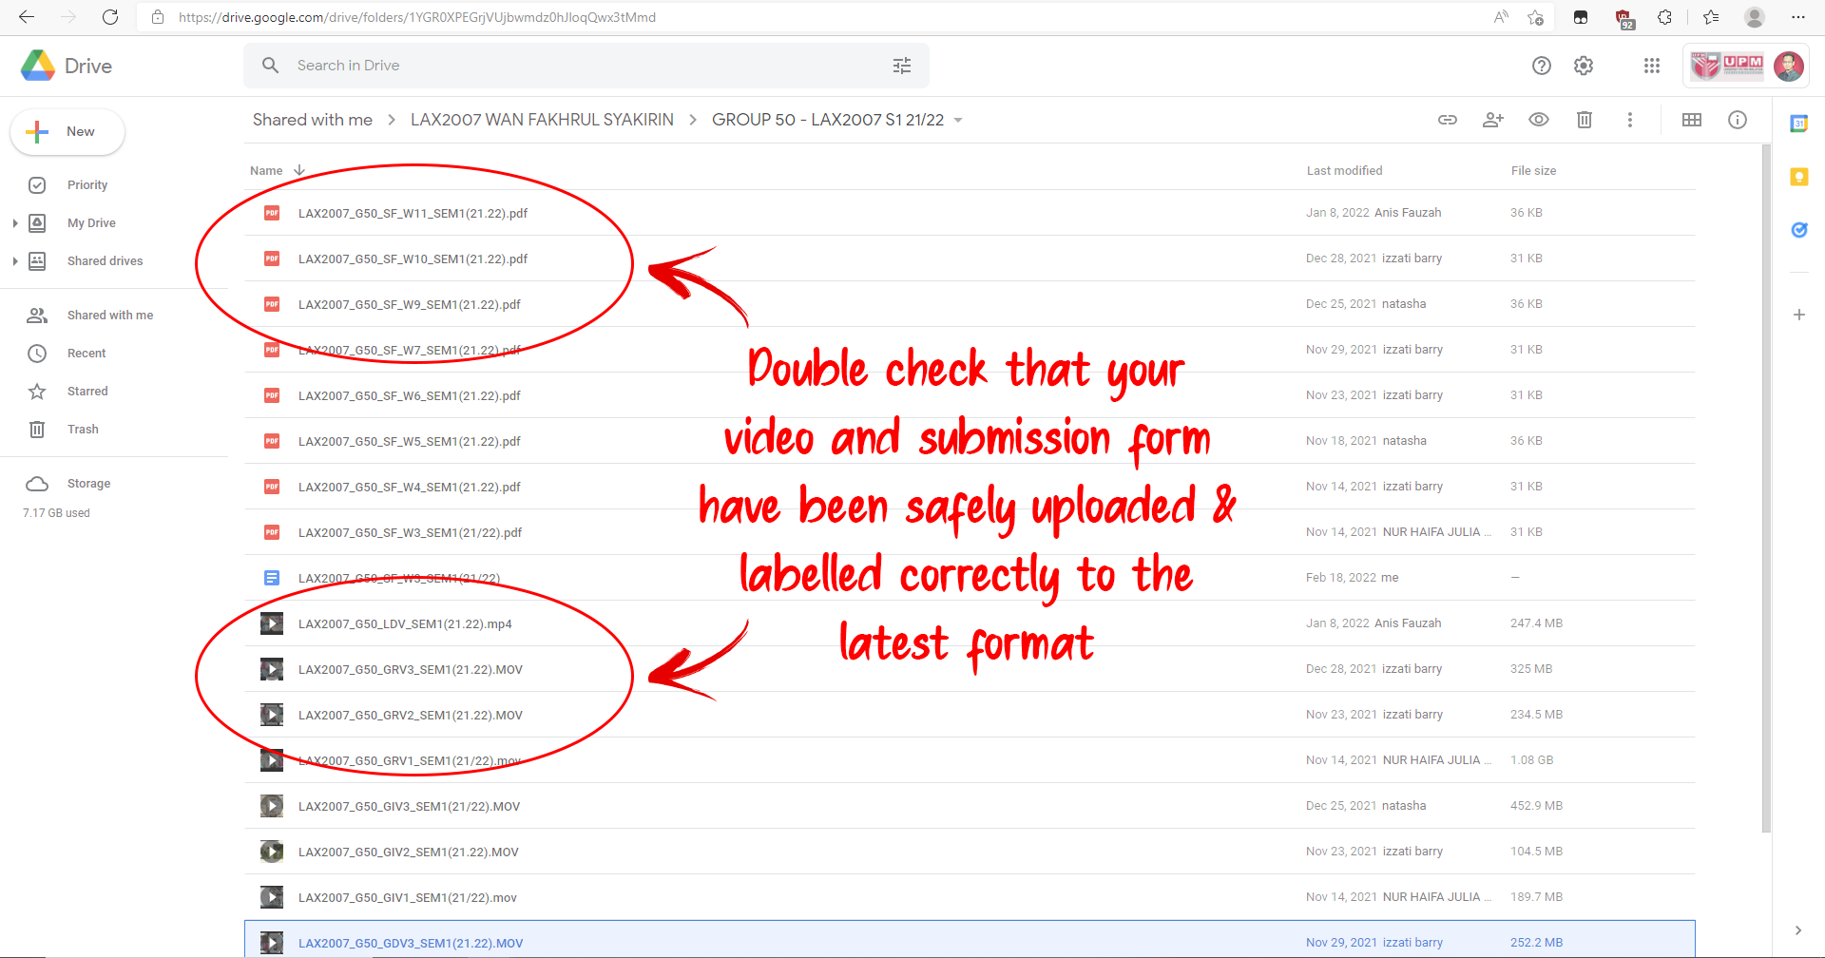
STEP 5: Check your submission. (This is meant for group leader only)

Slide 22
ASSESSMENT
Attendance (100%)
Task Completion (100%)
Participation in the group discussion videos
(LAX Week 1 – 6).
100% + 100%/2 = Must not be less than 80%
Students are not required to sign or submit any attendance forms.
Students must submit their MCs or excuse letters (if any) if they fail to attend any of the group discussion sessions to avoid from being awarded a zero for attendance.

Slide 23
Please check out the FAQ section in the website.
If you still cannot find the answer to your question, please contact your instructor directly or send an email to laxteam.upm@gmail.com
You can only afford to miss 1 group meetings. You are at risk of getting a TM if you miss more than ONCE. Please ensure that you have the documents to support your absence from group meetings.

Slide 24

THE END

